Slide 1
Chapter 9: Memory Management

Slide 2
Outline
Background
Contiguous Memory Allocation
Paging
Structure of the Page Table
Swapping
Example: Intel 32 and 64-bit Architectures
Example: ARMv8 Architecture

Slide 3
Outline
Background
Address Binding
Logical Versus Physical Address Space
Dynamic Loading
Dynamic Linking and Shared Library
Contiguous Memory Allocation
Paging
Structure of the Page Table
Swapping
Example: Intel 32 and 64-bit Architectures
Example: ARMv8 Architecture

Slide 4
Background
Main memory and registers are only storage CPU can access directly
Thus, program must be brought (from disk) into memory

Slide 5
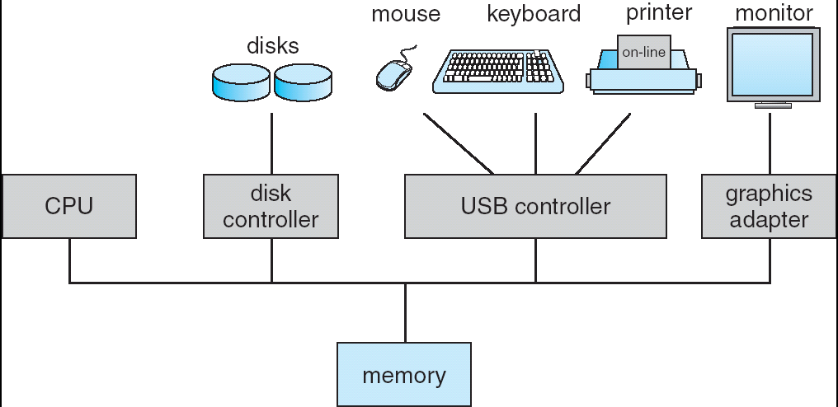
A Computer System
CPU registers

Slide 6
Question: Programmers use variables. But, CPUs access memory by addresses. 怎麼辦呢?
Hint: see the following slide

Slide 7
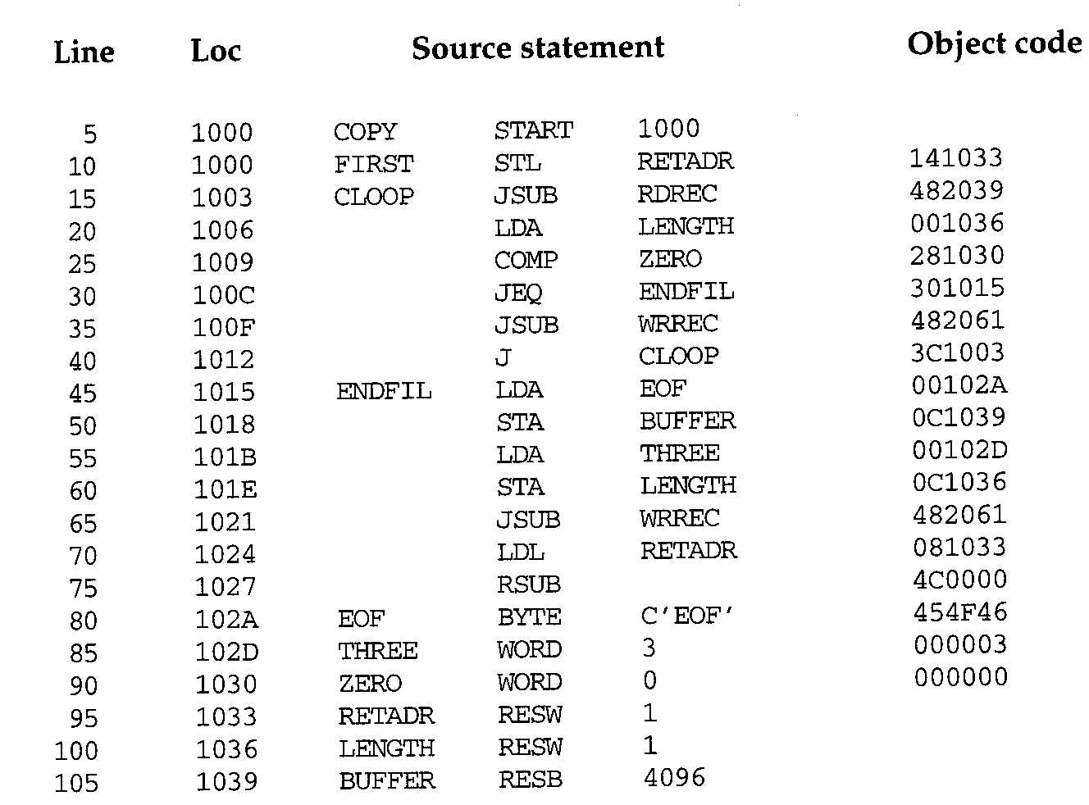
複習：Example of a SIC Assembler Language Program

Slide 8
Question: Programmers use variables. But, CPUs access memory by addresses. 怎麼辦呢?
Solution: Address Binding
將變數轉化為記憶體位址

Slide 9
Binding of Instructions and Data to Memory
Address binding: a mapping from one address space to the actual memory address

Slide 10
Q: 何時轉換呢?
Hint: 看程式開發過程中會經過哪些步驟?

Slide 11
Program Development Steps
User programs go through several steps before being run
Source code compiled into object files
Linker combines these object files into single binary executable file
Also brings in (statically linked) libraries
Loader brought the program (as binary executable on secondary storage) into memory to be executed

Slide 12
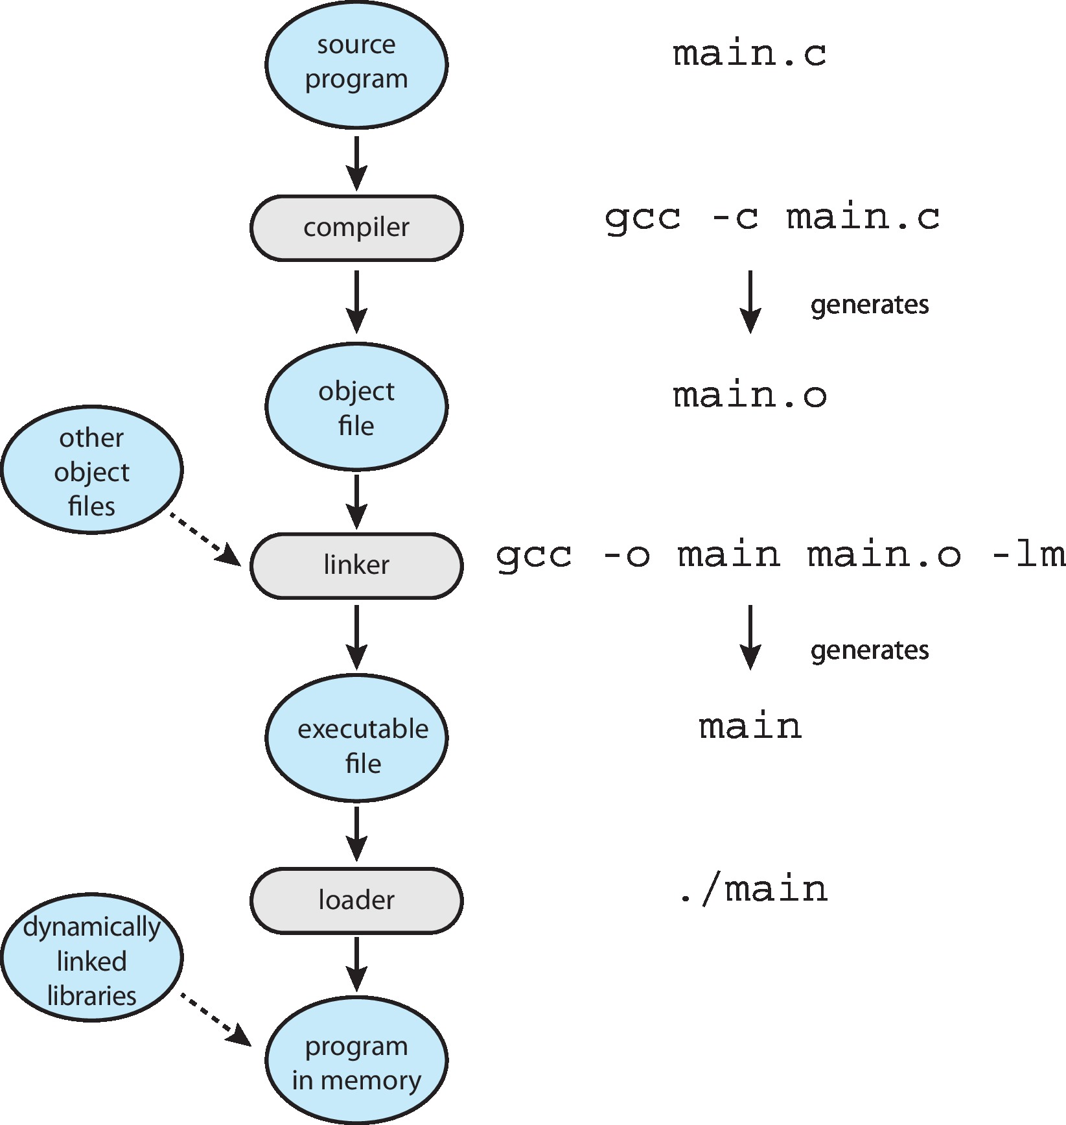

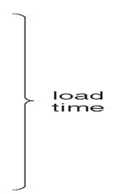

The Role of the Linker and Loader
statically linked library

Slide 13
Binding of Instructions and Data to Memory
Question: when to perform the binding?
Solutions: binding can be performed at compiler time, loading time, or execution time.

Slide 14
Address Binding
Binding of Instructions and Data to Memory
At compile time: e.g., SIC computer
At load time: e.g., SIC/XE computer
At execution time: e.g., x86 computer

Slide 15
Address Binding
Binding of Instructions and Data to Memory
At compile time: e.g., SIC computer
At load time: e.g., SIC/XE computer
At execution time: e.g., x86 computer

Slide 16
Binding at Compiler Time
Assume compiler time binding
Addresses in the source program are generally symbolic
such as the count
A compiler bind symbolic addresses to absolute addresses
such as 74014

Slide 17
複習：Example of a SIC Assembler Language Program

Slide 18
Binding at Compile Time
Symbolic Addresses
Absolute Addresses (Physical Memory Addresses)
PROGRAM
1024
JUMP abc
JUMP 1424
abc:
1424
LOAD xyz
LOAD 2224
Compile
Link
DATA
int xyz
2224
Source Code
Absolute Load Module

Slide 19
Binding at Compile Time (Cont.)
Absolute Addresses (Physical Memory Addresses)
1024
JUMP 1424
1424
Load
LOAD 2224
2224
Process Image (Part)

Slide 20
Q: Compiler time做binding有什麼缺點呢?

Slide 21
Address Binding
Binding of Instructions and Data to Memory
At compile time: e.g., SIC computer
At load time: e.g., SIC/XE computer
At execution time: e.g., x86 computer

Slide 22
Binding at Loading Time
Assume loading time binding
A compiler bind symbolic addresses to relocatable addresses
such as “14 bytes from beginning of this module”
Linker or loader bind relocatable addresses to absolute addresses
such as 74014

Slide 23
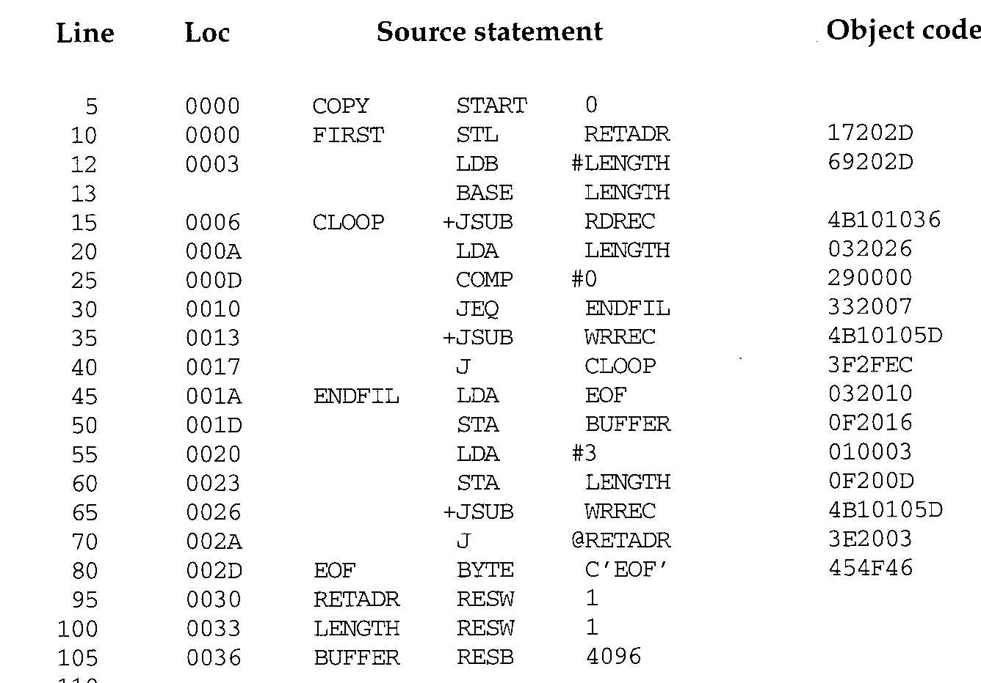
Example of a SIC/XE Program (Fig 2.5,2.6)

Slide 24
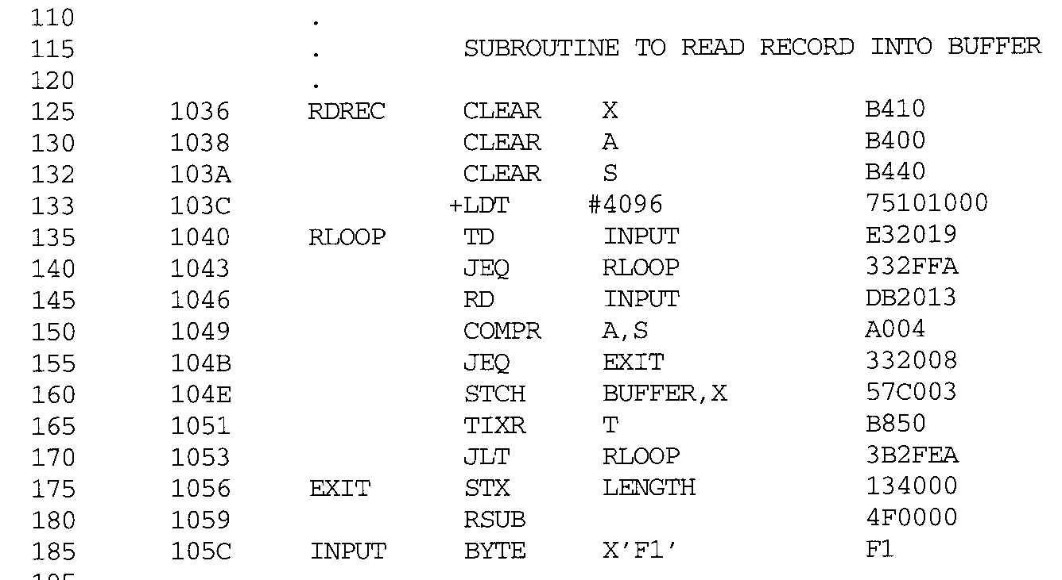
Example of a SIC/XE Program (Fig 2.5,2.6) (Cont.)

Slide 25
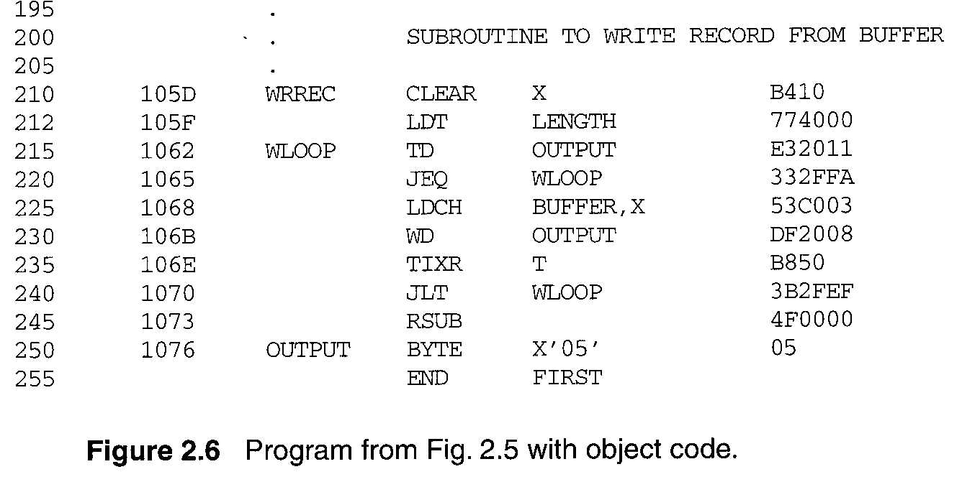
Example of a SIC/XE Program (Fig 2.5,2.6) (Cont.)

Slide 26
Binding at Loader Time
Symbolic Addresses
Relative (Relocatable)
Addresses
PROGRAM
0
JUMP xyz
JUMP 400
xyz:
400
LOAD abc
LOAD 1200
Compile
Link
DATA
abc
1200
Source Code
Relative Load Module

Slide 27
Binding at Loader Time (Cont.)
Absolute Addresses (Physical Memory Addresses)
1024
JUMP 1424
1424
Load
LOAD 2224
2224
Process Image (Part)

Slide 28
Loading time 做binding很好, 但是因為記憶體管理的特性, 所以目前使用execution time binding

Slide 29
Address Binding
Binding of Instructions and Data to Memory
At compile time: e.g., SIC computer
At load time: e.g., SIC/XE computer
At execution time: e.g., x86 computer
本章會介紹

Slide 30
Summary: Binding of Instructions and Data to Memory
At compile time: e.g., SIC computer
Compiler generate absolute code
Memory location must known a priori
The program must be loaded at fixed address
At load time: e.g., SIC/XE computer
Compiler must generate relocatable code
Loader binds relocatable addresses to absolute address
At execution time: e.g., x86 computer
Need hardware support for address maps
Used in current computers (paging, swapping)

Slide 31
Outline
Background
Address Binding
Logical Versus Physical Address Space
Dynamic Loading
Dynamic Linking and Shared Library
Contiguous Memory Allocation
Paging
Structure of the Page Table
Swapping
Example: Intel 32 and 64-bit Architectures
Example: ARMv8 Architecture

Slide 32
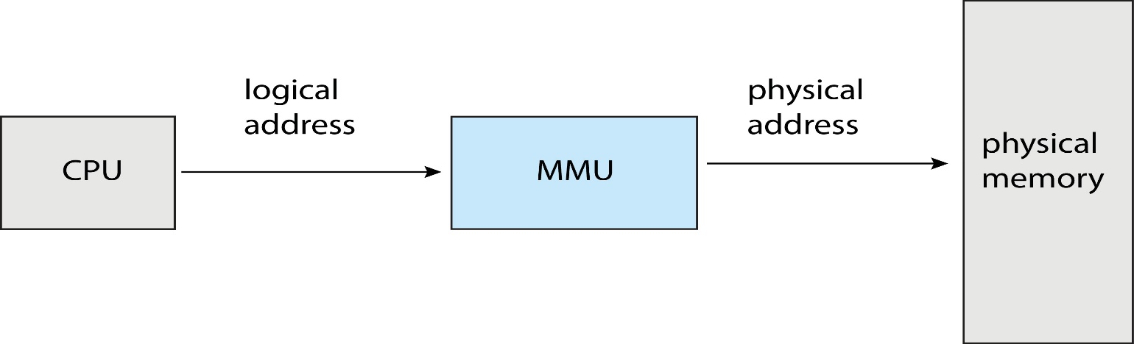
Current computers have execution-time binding
The addresses generated by CPU are different from that seen by memory

Slide 33
Logical vs. Physical Address Space
Logical address – generated by CPU; also referred to as virtual address
Physical address – addresses seen by the memory unit
Logical address space
All logical addresses generated by a program
Physical address space
Set of physical addresses corresponding to these logical addresses

Slide 34
Q1: 為什麼要dynamic binding?
Shown later

Slide 35
Q2: 所以CPU送出來的logical address必須轉換為physical address, 由誰負責轉換呢?
Ans: see the following slide

Slide 36
Memory-Management Unit (MMU)
Run-time mapping from virtual to physical addresses is performed by MMU (Memory-Management Unit)
MMU: a hardware device that maps virtual to physical address

Slide 37
Q: 為什麼不是OS負責轉換呢?

Slide 38
OS不知道發生記憶體存取
…
mov eax, 10
mov temp, eax
…
CPU
…..
eax | 10
OS

Slide 39
Q3: 如何轉換呢?
Ans: 看個簡單的例子

Slide 40
A Simple MMU Using a Relocation Register
Example: a simple MMU
假設compiler產生的起始位置為0
但是loader將程式載入到記憶體起始位置為14000的地方
如下圖
Q: 怎麼辦呢?
The relocation register is added to every (virtual) address

Slide 41
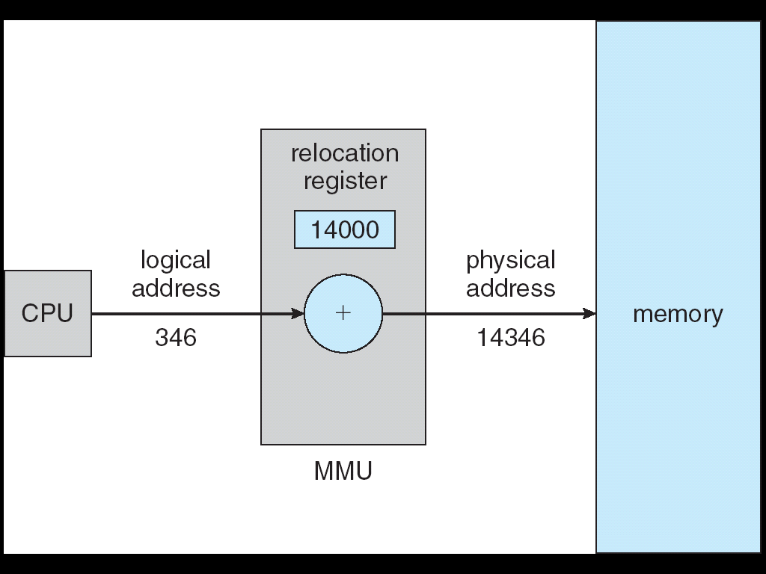
A Simple MMU Using a Relocation Register

Slide 42
事實上, 目前使用的方法更強悍~

Slide 43
Outline
Background
Address Binding
Logical Versus Physical Address Space
Dynamic Loading
Dynamic Linking and Shared Library
Contiguous Memory Allocation
Paging
Structure of the Page Table
Swapping
Example: Intel 32 and 64-bit Architectures
Example: ARMv8 Architecture

Slide 44
Dynamic Loading
So far, the entire program must be in physical memory for execution
但是, 有需要嗎?

Slide 45
Dynamic Loading
Sol.: Dynamic Loading
A routine is not loaded until it is called
Useful when large amounts of code are needed to handle infrequently occurring cases
優點:
Better memory-space utilization
Unused routine is never loaded

Slide 46
Outline
Background
Address Binding
Logical Versus Physical Address Space
Dynamic Loading
Dynamic Linking and Shared Library
Contiguous Memory Allocation
Paging
Structure of the Page Table
Swapping
Example: Intel 32 and 64-bit Architectures
Example: ARMv8 Architecture

Slide 47
複習：Linking做了什麼事情呢？
Ans: Resolve External References

Slide 48
Example of Programs Using Libraries in Linux
int add(int arg) {
arg++;
return arg;
}
int sub(int arg) {
arg--;
return arg;
}
int abc() {
…
}
a.c
int sum(int arg1, int arg2)
{
return (arg1+arg2);
}
int xyz()
{
……
}
b.c

Slide 49
Example of Programs Using Libraries in Linux (Cont.)
libtmp.a
a.c
Compiler
a.o
a.o
link utility
Compiler
b.o
b.c
b.o
Creating a library called libtmp.a

Slide 50
Example of Programs Using Libraries in Linux (Cont.)
#include <stdio.h>
extern int add(int);
extern int sub(int);
extern int sum(int, int);
main()
{
int ret1, ret2, ret3;
ret1 = add(5);
ret2 = sub(5);
ret3 = sum(ret1, ret2);
printf("\n ret from add()= %d", ret1);
printf("\n ret from sub()= %d", ret2);
printf("\n ret from sum()= %d", ret3);
}
main.c

Slide 51
Example of Programs Using Libraries
Object file
executable file
Source file
main.c
Compiler
main.o
main.o
linker
libtmp.a
libtmp.a
a.o
a.o
b.o
b.o
Link with libtmp.a to create the executable file

Slide 52
複習完畢

Slide 53
Dynamic Linking
Static linking
如前面的例子
System libraries and program code combined into the binary program image before execution
Waste space for shared libraries (see the following slide)
Q: 怎麼辦呢?

Slide 54
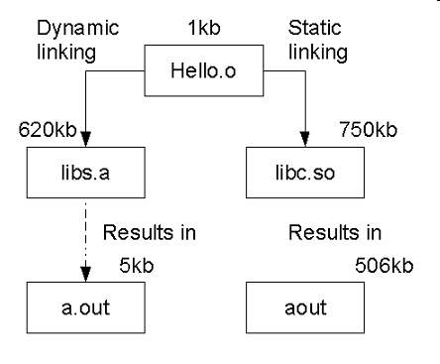
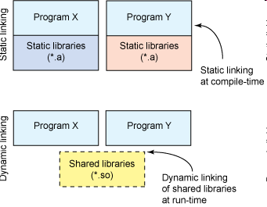
Static Linking v.s. Dynamic Linking
so
so
a
http://www.scienceprog.com/embedded-c-program-libraries-and-linking/
http://www.scienceprog.com/embedded-c-program-libraries-and-linking/

Slide 55
Dynamic Linking
Sol.: Dynamic linking
Linking postponed until execution time

Slide 56
Static Linking v.s. Dynamic Linking
statically linked library

Slide 57
Dynamic Linking (Cont.)
Modern systems don’t statically link libraries into executables
Instead, dynamically linked libraries (DLL) is used
A dynamically linked library is linked and loaded if it is required during run time
A dynamically linked library is shared (loaded once)
Savings in memory use

Slide 58
Dynamic Linking
Advantages
Reduce the size of an executable image and used memory size.
Particularly useful for libraries
Libraries can be shared among multiple processes
Only one instance is needed
Needs to be loaded in main memory only once
Such libraries are called dynamically linked library (DLLs) or shared library
Windows: .DLL files
Unix: .so files (shared library)

Slide 59
Dynamic Loading和Dynamic Linking到底有什麼不同呢?
See the following example

Slide 60
Example
See the following slides
1. load program X into memory (via exec())
2. When X calls printf() (it’s address is zero when compiling)
Load libc => dynamic loading
Resolve external references => dynamic linking
Modify 000000 to say, 0x350060
3. Later, Y is also loaded into memory via exec()
4. When Y calls printf() (it’s address is also zero when compiling)
Resolve external reference => dynamic linking
Modify 000000 to 0x350060

Slide 61
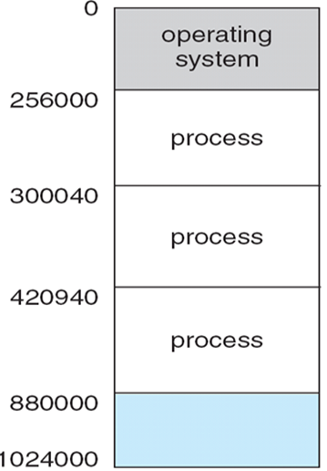
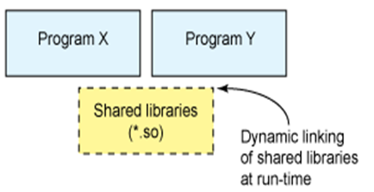
Example: load program X into memory via exec()
external reference to printf()
000000
X
libc
Y
Notably, the external reference to printf()’s address is 000000

Slide 62
Example: When X calls printf()
external reference to printf()
350060
X
350060
Printf{};
libc
Y

Slide 63
Example: load program Y into memory via exec()
external reference to printf()
350060
X
350060
Printf{};
libc
Y
external reference to printf()
000000

Slide 64
Example: When Y calls printf()
external reference to printf()
350060
X
350060
Printf{};
libc
Y
external reference to printf()
350060

Slide 65
作業系統實驗會有一個Static Linking vs Dynamic Linking的實驗

Slide 66
Outline
Background
Contiguous Memory Allocation
Paging
Structure of the Page Table
Swapping
Example: Intel 32 and 64-bit Architectures
Example: ARMv8 Architecture

Slide 67
How to Allocate Memory to a Process?
Sol. Contiguous Memory Allocation

Slide 68
Contiguous Memory Allocation
Contiguous memory allocation
Each process is contained a single contiguous
section of memory

Slide 69
Outline
Background
Contiguous Memory Allocation
Memory Protection
Memory Allocation
Fragmentation
Paging
Structure of the Page Table
Swapping
Example: Intel 32 and 64-bit Architectures
Example: ARMv8 Architecture

Slide 70
Background
Two concerns of memory
Access speed
Protection of memory

Slide 71
Q: 何謂記憶體保護?
Ans: Need to ensure that a process can only access its own space (see the following slide)

Slide 72
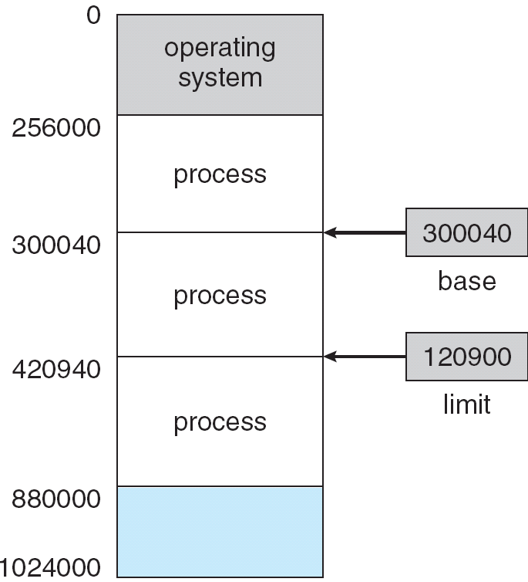
Protection of Memory

Slide 73
Q: 如何實現記憶體保護?
Ans: 每一此存取記憶體時, 一定要檢查是否合法

Slide 74
Q: 誰負責提供記憶體保護?
Ans: Protection is provided by the hardware (MMU)
不是OS! 注意, OS doesn’t intervene between the CPU and memory accesses (see the following slide)

Slide 75
OS不知道發生記憶體存取
…
mov eax, 10
mov temp, eax
…
CPU
…..
eax | 10
OS

Slide 76
看一個簡單的例子
假設是compiler time/load time做binding

Slide 77
A Simple Example: Basic Hardware
(Base + Limit) scheme
A simple method: MMU provides two registers
Base register: hold the smallest memory address
Limit register: specify the size
MMU
Protect the memory by base and limit register

Slide 78
Base and Limit Registers
A pair of base and limit registers define the logical address space

Slide 79
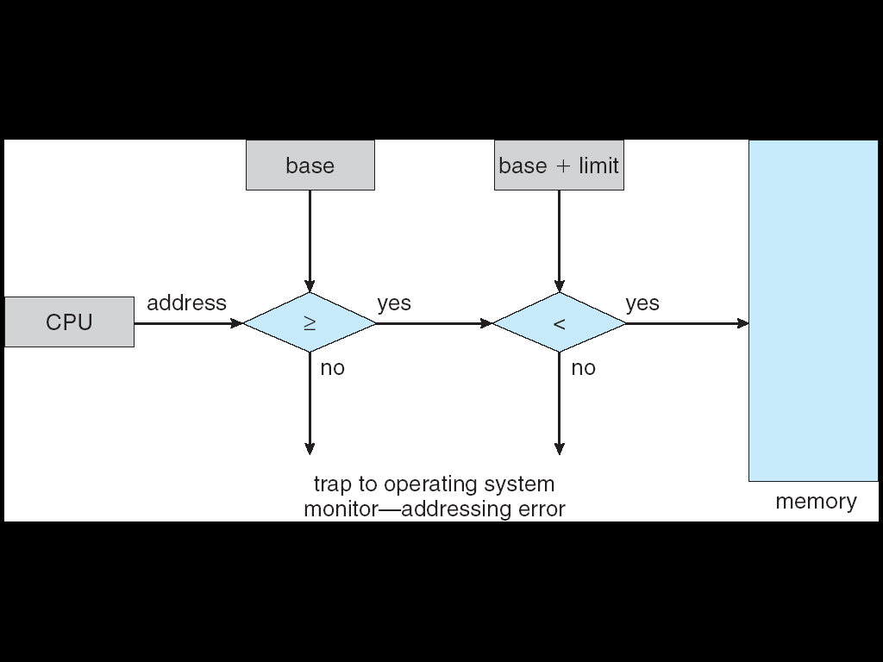
Hardware Address Protection with Base and Limit Registers
On each memory access -- MMU must check every memory access

Slide 80
再看一個簡單的例子
假設是execution time做binding

Slide 81
Memory Protection
(Relocation + Limit) scheme
Assume (see the following slide)
The program’s starting address generated by compiler is 0x0
程式大小為0x1600
程式被載入到記憶體起始位置為0x2000的位址
Relocation register: contains value of smallest address (0x2000)
Limit register: contains range of addresses (0x1600)
MMU
Memory protection: By limit register
Run-time binding: maps logical address dynamically to physical address
Relocation register is added to every address generated by a user process

Slide 82

Hardware Support for Relocation and Limit Registers
On each memory access ---
Relative (Relocatable)
Addresses
MMU
0
JUMP 400
400
LOAD 1200
1200
1600
Relative Load Module

Slide 83
Q: Relocation (or base), and Limit registers can only be loaded (by privileged instructions) by the OS. Why?
Hint: modifying these two registers are privilege instructions

Slide 84
當process context switch, OS 必須重新載入 relocation (or base) and limit registers 的值.
See the following slide

Slide 85
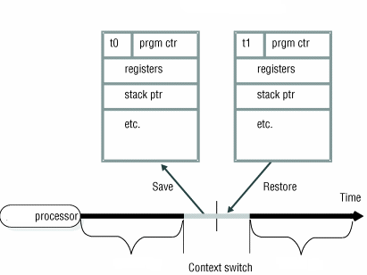
CPU Switch From Process to Process
PCB₀
PCB₁
relocation
relocation (300040)
Limit (120900)
relocation (420940)
Limit (459060)
process₀
process₁

Slide 86
Q: 當thread context switch, OS是否也必須重新載入 relocation (or base) and limit registers 的值呢? Why?

Slide 87
Solution : Multiple Threads Solution
one process
memory
code
Thread 1
data
stack
Thread 2
stack
stack
Thread 3
stack
Thread 4

Slide 88
複習: 所以,第四章提到thread context switch overhead小於process context switch overhead
後面會再看到

Slide 89
複習: Context Switches between Threads - Similar to Context Switch between Processes
CPU
eax = 8 ;
ebx = 11;
Thread 1
main()
{
.
a = a +1;
pthread_create(..runner());
}
runner()
{
.
.
b = b + 5;
c = b * 10;
}
eax = 3;
ebx = 19;
eax = 8;
ebx = 11;
Thread 1
Thread 1
Context switch
Thread 2
eax = 8 ; ebx = 11;
TCB₁
Thread 2
TCB
(in memory)
Thread 2
TCB₂
Context switch
Change to Thread 1
eax = 3 ; ebx = 19;

Slide 90
複習: Benefits
Responsiveness
If one thread is blocked, other threads can continue running
Resource Sharing
Threads share the memory (code and data) and resources of the process to which they belong
Economy
Create and context-switch thread is much quickly than processes
Scalability
Multithreading on a multi-CPU machine increases concurrency
Each thread may be running in parallel

Slide 91
複習完畢

Slide 92
Outline
Background
Contiguous Memory Allocation
Memory Protection
Memory Allocation
Fragmentation
Paging
Structure of the Page Table
Swapping
Example: Intel 32 and 64-bit Architectures
Example: ARMv8 Architecture

Slide 93
Q: Where to Allocate Memory to a Process?

Slide 94
Memory Allocation
At any time, memory consists of variable-sized Used partitions and free partitions (i.e. holes)
When a process arrives, it is allocated a hole large enough to accommodate it
When a process terminates, its allocated memory is returned to the set of hole
Maybe merged with adjacent holes

Slide 95
Example of Variable-Partition Scheme for Memory Allocation
OS
OS
OS
OS
process 5
process 5
process 5
process 2
process 2
process 8
OS
OS
process 5
merge
process 8
process 8
From Ka, Ha-Zen

Slide 96
Dynamic Storage-Allocation Problem
How to satisfy a request of size n ?
First-fit: Allocate the first hole that is big enough
Best-fit: Allocate the smallest hole that is big enough
Must search entire list, unless ordered by size
Worst-fit: Allocate the largest hole
Must search entire list, unless ordered by size
First-fit and best-fit better than worst-fit in terms of speed and storage utilization
Furthermore, first-fit is faster. Why?

Slide 97
Outline
Background
Contiguous Memory Allocation
Memory Protection
Memory Allocation
Fragmentation
Paging
Structure of the Page Table
Swapping
Example: Intel 32 and 64-bit Architectures
Example: ARMv8 Architecture

Slide 98
Fragmentation
External Fragmentation –
50-percent rule: for first fit, given N allocated blocks, another 0.5N will be lost to fragmentation
1/3 of memory may be unusable!!!
Solutions to reduce external fragmentation
Solution1: Compaction
Shuffle (把.移來移去) memory contents to place all free memory together in one large block
Solution2: non-contiguous memory allocation
Allow the physical address of the processes to be noncontiguous
E.g, paging

Slide 99
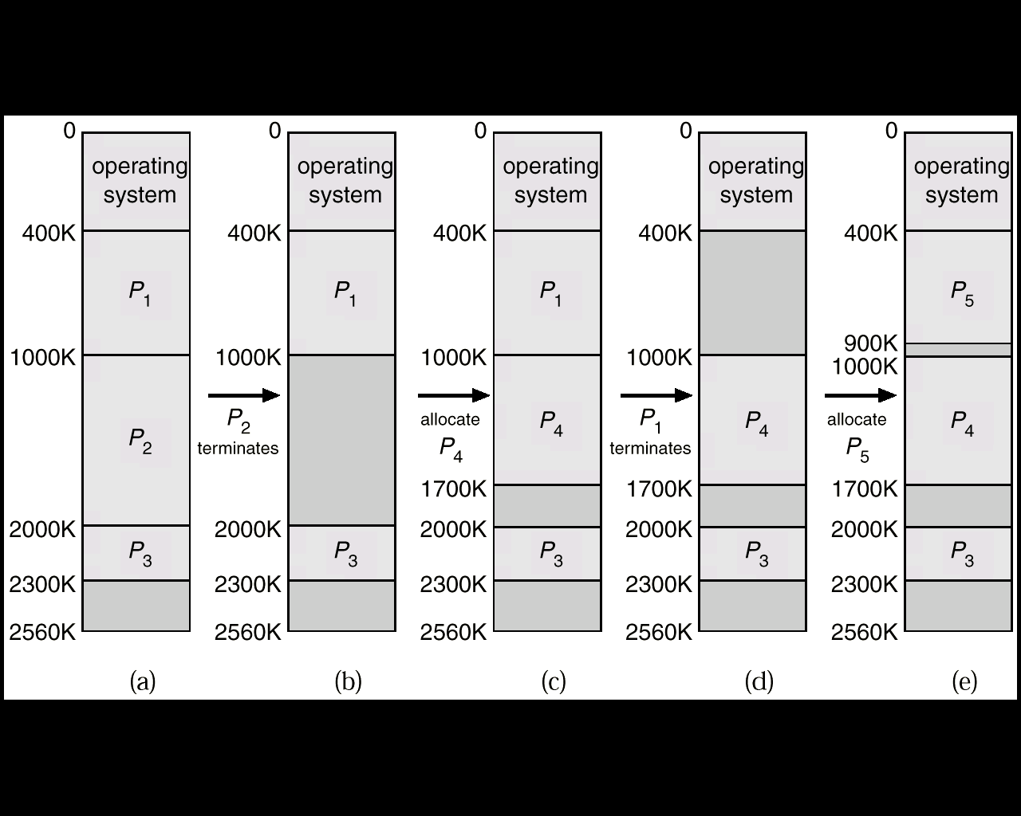
External Fragmentation
A request of 650 KB.
Total memory is big enough but cannot satisfy this request

Slide 100
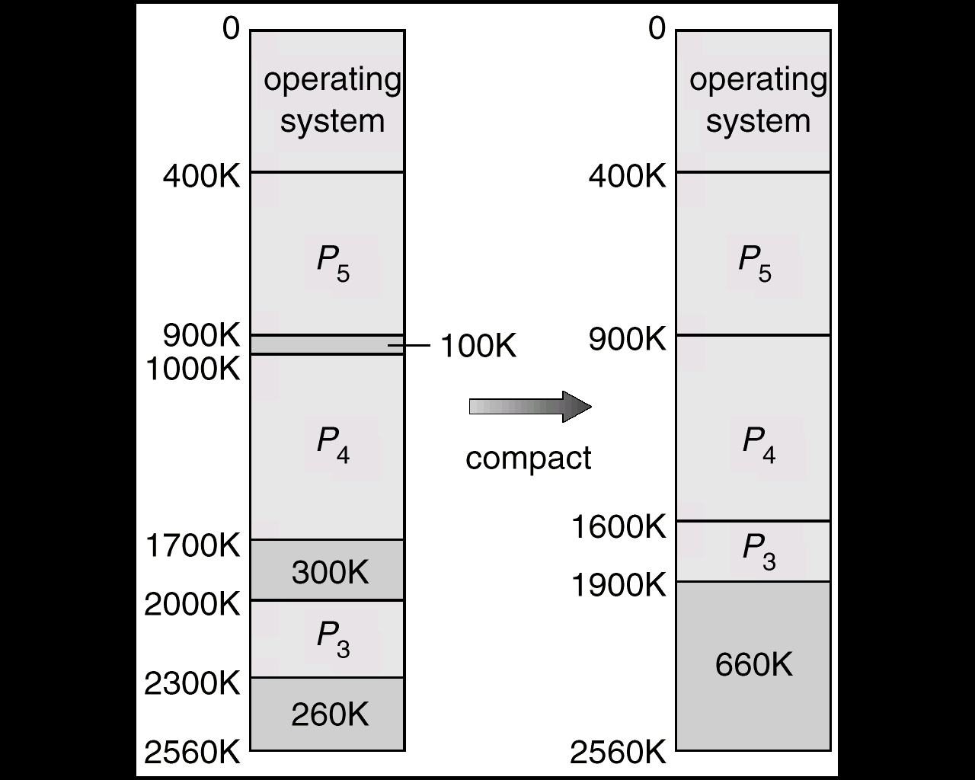
Compaction (I)
From Ka, Ha-Zen

Slide 101
Fragmentation (Cont.)
Internal Fragmentation
Usually, physical memory is broken into fixed-sized blocks
Memory is allocated to processes in unit of block sizes
Allocated memory may be slightly larger than requested memory
Example
A block = 1024 bytes
Request memory = 1000 bytes
Allocated memory = 1 block = 1024 bytes
Internal fragmentation = 24 bytes
This size difference is internal to a partition, but not being used

Slide 102
Outline
Background
Contiguous Memory Allocation
Paging
Basic Method
Hardware Support
Protection
Shared Pages
Structure of the Page Table
Swapping
Example: Intel 32 and 64-bit Architectures
Example: ARMv8 Architecture

Slide 103
Paging
Introduction
Widely used, ranging from server to mobile devices
Implemented through cooperation between OS and hardware

Slide 104
Q: How to Implement Non-Contiguous Memory Allocation?
程式在記憶體是不連續擺放的

Slide 105
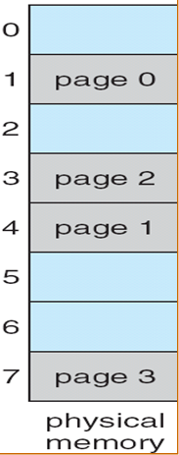
Idea of Paging
Physical address space of a process is noncontiguous

Slide 106
Idea of Paging
But, logically, program is consider continuous by programmers/compilers
0
JUMP 400
400
LOAD 1200
1200
Program

Slide 107
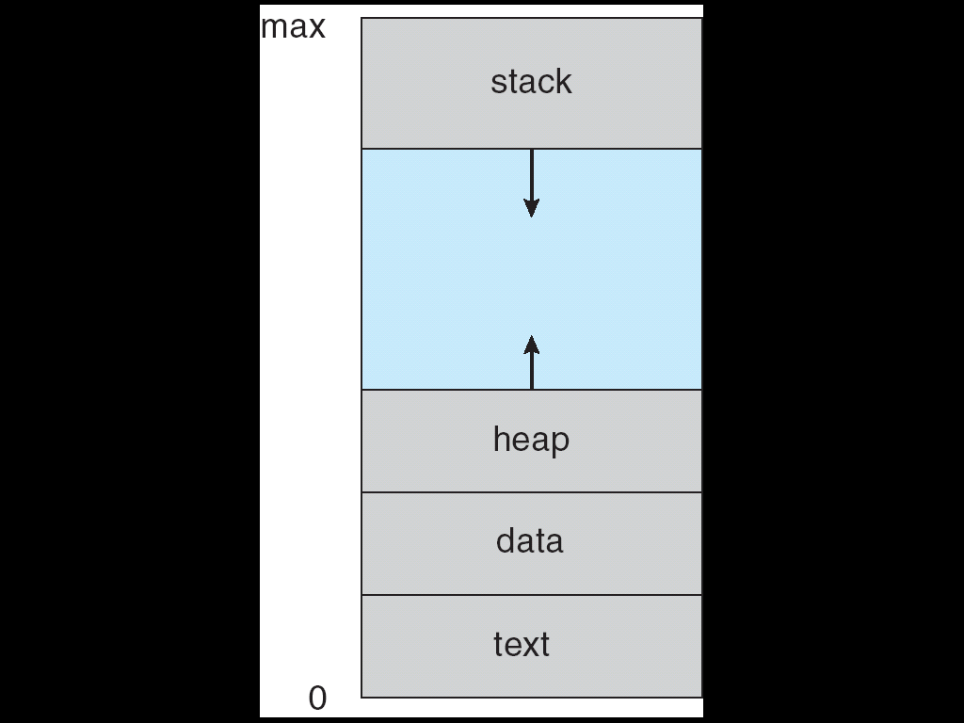
複習：Process
Logical memory

Slide 108
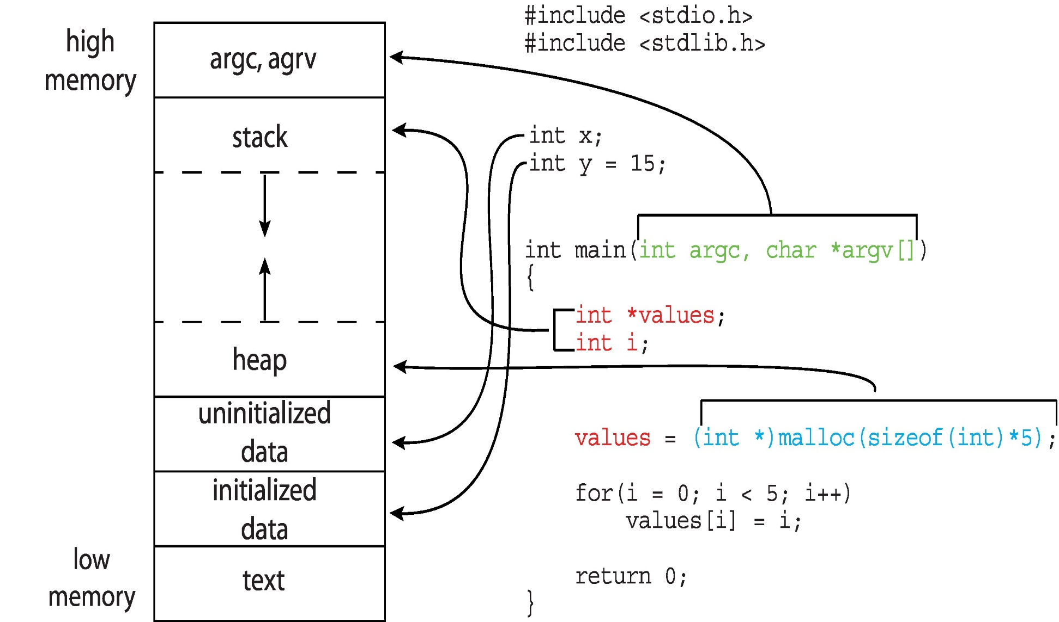
複習： Actual Memory Layout of a C Program
Logical memory

Slide 109
Question: how to translate from logical memory to physical memory?
0
400
1200
Program

Slide 110
Basic Method
Divide physical memory into fixed-sized blocks called frames
Size is power of 2, between 4 KB and 1 GB
Defined by hardware. Why?
See the following slide
Divide logical memory into blocks of the same size called pages

Slide 111
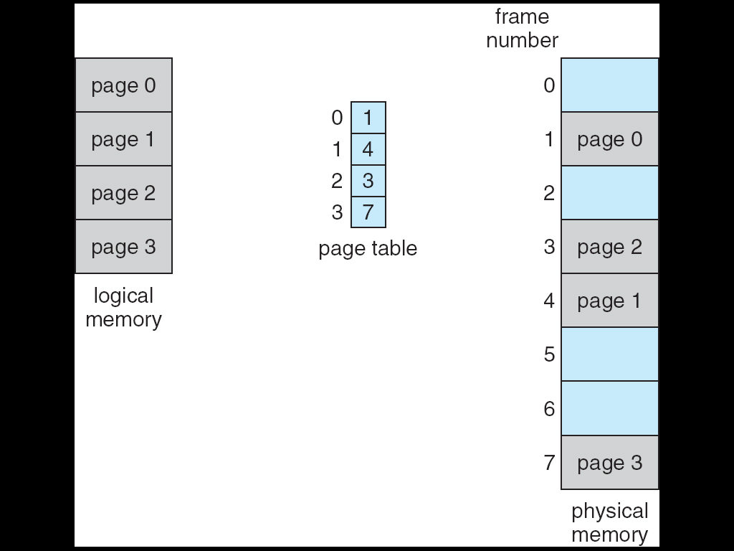
Paging Model of Logical and Physical Memory

Slide 112
Question: how to translate from logical memory to physical memory?
Ans: OS sets up a page table to translate logical to physical addresses for each process
(see the following slide)

Slide 113
Paging Model of Logical and Physical Memory

Slide 114
Paging Characteristics
Characteristics
Do not have external fragmentation problem
Still have Internal fragmentation

Slide 115
Q: 誰負責轉換?
Ans: MMU

Slide 116
複習: Memory-Management Unit (MMU)
Run-time mapping from virtual to physical addresses is performed by MMU (Memory-Management Unit)
MMU: a hardware device that maps virtual to physical address

Slide 117
複習: Q: 為什麼不是OS負責轉換呢?

Slide 118
複習: OS不知道發生記憶體存取
…
mov eax, 10
mov temp, eax
…
CPU
…..
eax | 10
OS

Slide 119
Q: MMU如何將logical address轉換為physical address呢?

Slide 120
Address Translation Scheme
Address generated by CPU is divided into:
Page number (p) – 代表存取哪一個page
Used as an index into a page table)
Page offset (d) –代表存取page內的哪一個byte
Combined with base address to define the physical memory address
As shown below, logical address = m bits, page number = m-n bits, offset = n bits
Logical address space = 2^{m}, Page size = 2^{n}, Page table has 2^{m-n} entries
page number
page offset
p
d
m - n
n

Slide 121

Paging Hardware

Slide 122
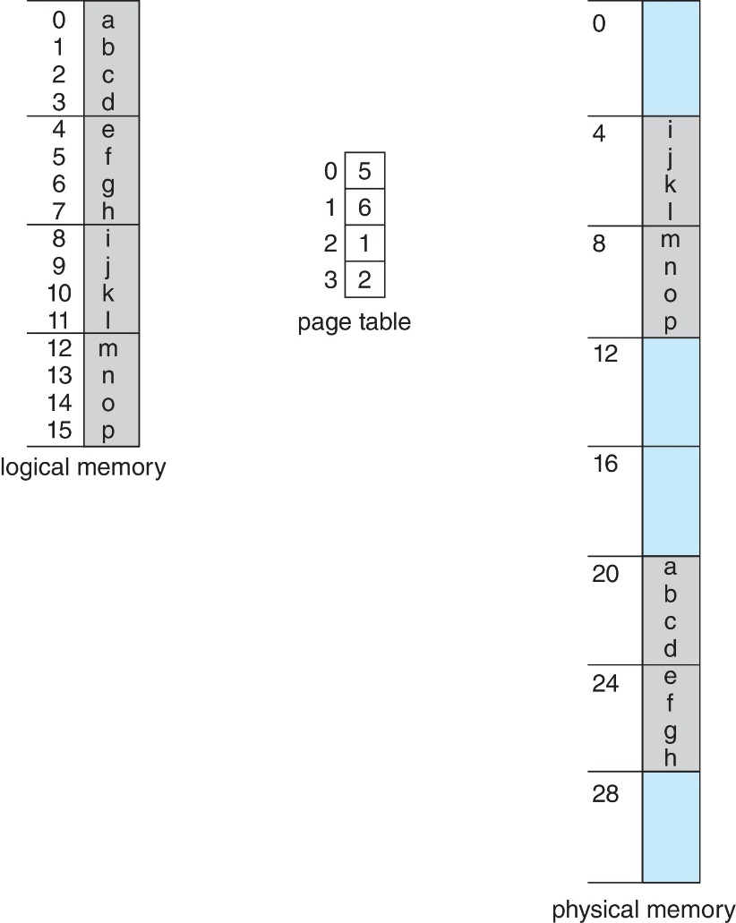
Paging Example 1
Logical Address Space: 32 bytes, Physical Memory: 32 bytes, Page Size: 4 bytes
m = 5, n = 2
Logical address = 00000 (=0)
p = 000, d = 00
Look up page table
Frame number = 101(=5)
Physical address = 10100 =20
Logical address = 01101(=13)
p = 011, d = 01
Look up page table
Frame number = 010(=2)
Physical address = 01001(=9)

Slide 123
Paging Example 2
Assume a 32-bit CPU, each page (frame) = 4KB
m = 32 bits
Logical address space = 2^32 = 4GB
Since page size = 4KB
n = 12 (因為2^12 = 4KB) (4KB page需要12 bits存取，所以page offset=12 bits)
p = 32-12 = 20
Or since page size = 4KB
p = 20 (2^32 / 4KB = 2^32/2^12 = 2^20 pages)
4G 虛擬記憶體空間(2^32)有2^20 個pages，所以page table需要2^20個entries
n = 32-20 = 12

Slide 124
Q1: Who maintain the page table?
Answer by Yourself~

Slide 125
Q2: 如何維護?
Shown later

Slide 126
Q3: Who use the page table?
Answer by Yourself~

Slide 127
Q: 當要載入一個process時, OS如何知道那些frames是空的呢?
Hint: OS must maintain the Location of Free Frames.

Slide 128
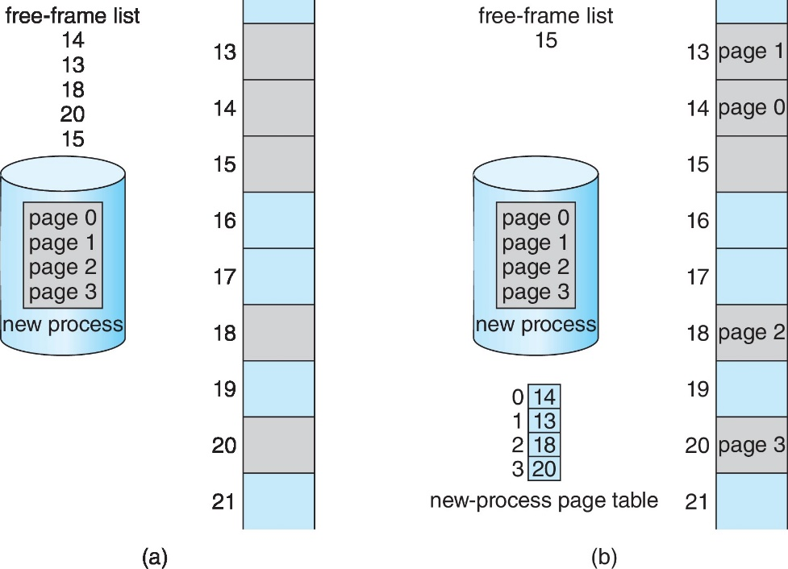
Allocating Frames to a Process
OS maintain a free-frame list
Before Allocation
After Allocation

Slide 129
複習: Q2: 如何維護page table?
從上圖, 我們知道OS如何維護page table

Slide 130
Q: OS何時會建立page table?
Ans: fork() and exec()

Slide 131
複習: The fork() System Call
Memory
Copy from original image
Original image
fork()
New image
NCHU System & Network Lab

Slide 132
複習: The exec() System Call
Memory
Copy from original image
Original image
fork()
Load another image
New image
exec()
NCHU System & Network Lab

Slide 133
Frame Table
In addition to page table, OS maintains a frame table to keep track of all frames
An entry for each physical frame
Whether frame is free or allocated
If allocated, to which page of which process
See the next slide

Slide 134
.
.
.
.
13
free
13
(P_{j}, page 1)
frame
table
14
free
14
(P_{j} , page0)
frame
table
15
free
15
free
16
(P_{i} ,page3)
16
(P_{i} ,page3)
.
.
.
.
Before Allocation
After Allocation

Slide 135
Summary
Paging provides a clear separation between the user’s view of memory and the actual physical memory
User program views memory as one single space
In fact, the single space map to non-contiguous physical frames
The translation is done by the address translation hardware (MMU) by consulting the page table
The page table is maintained by the OS

Slide 136
Outline
Background
Contiguous Memory Allocation
Paging
Basic Method
Hardware Support
Protection
Shared Pages
Structure of the Page Table
Swapping
Example: Intel 32 and 64-bit Architectures
Example: ARMv8 Architecture

Slide 137
Q: 每一個process有自己的page table或是整個系統只有一份page table?
See the following slide

Slide 138
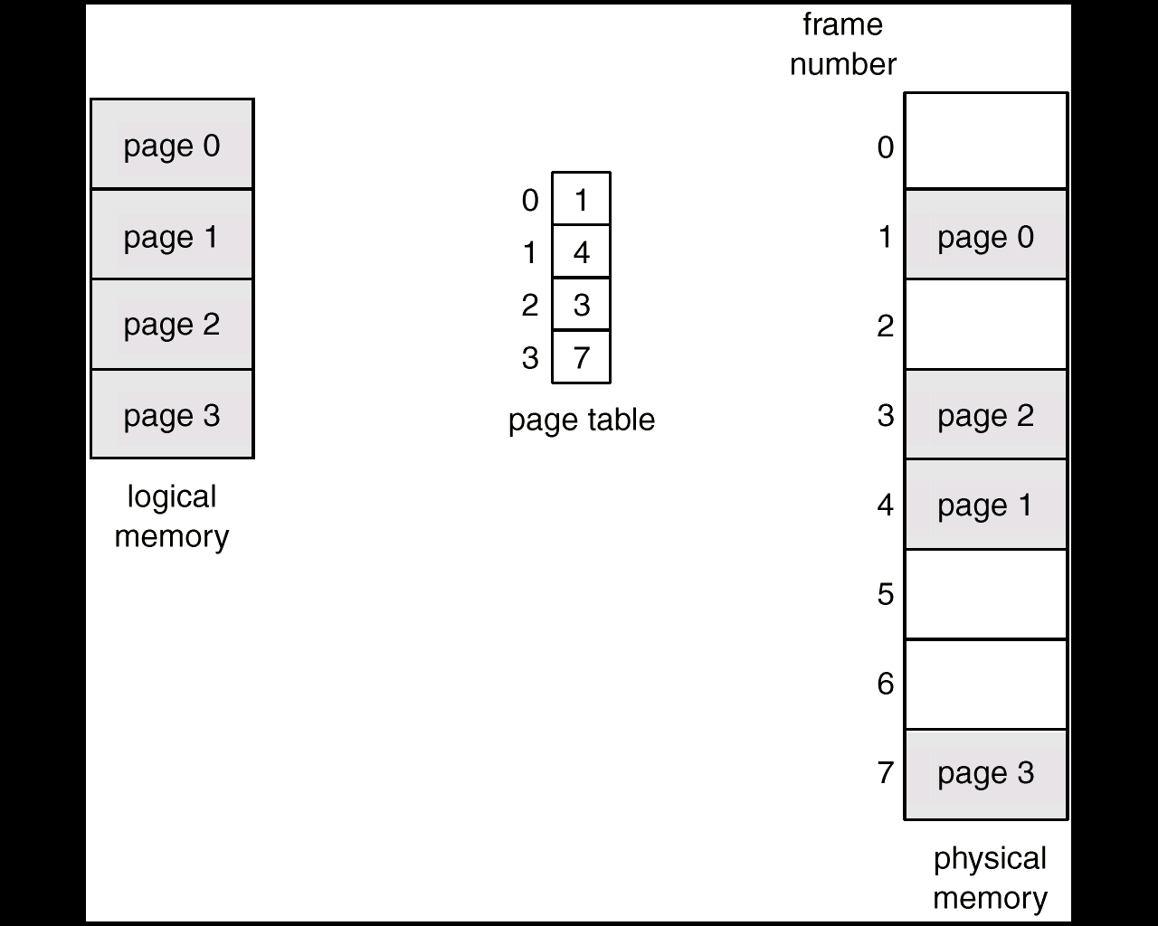
Per-Process Page Table
Each process has its own physical frames, OS maintains a page table for each process
A pointer to a process’s page table is stored in its PCB
Page 3
(P0)
Page 2
0
6
Page 1
1
5
Page 0
(P1)
2
2
3
0

Slide 139
Q: Where is the page table?
Ans: page table is stored in main memory.

Slide 140
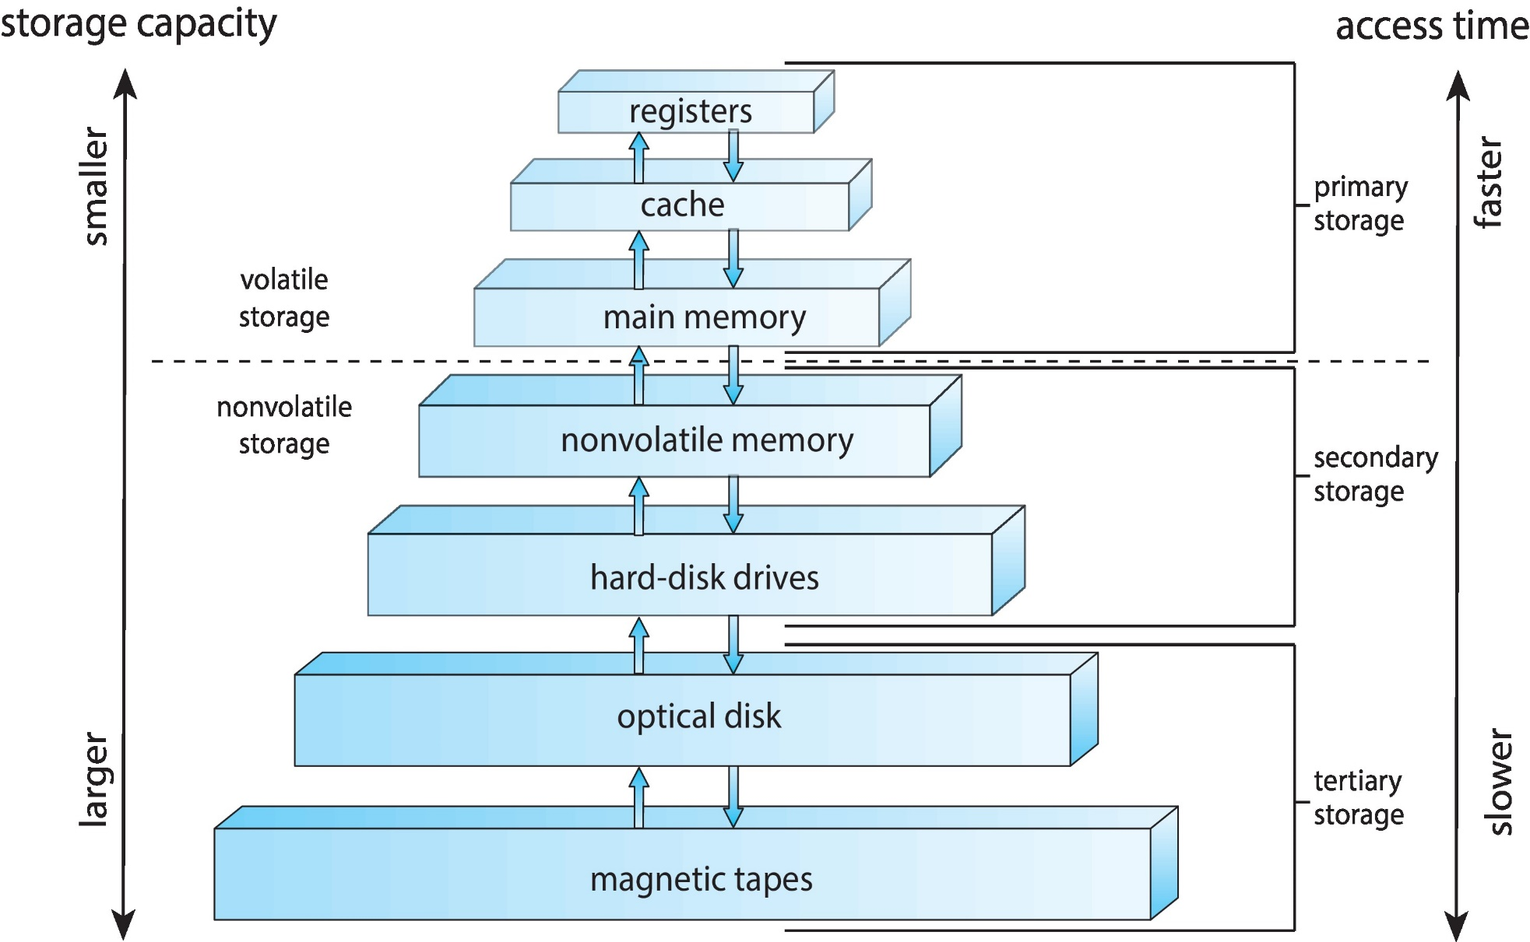
複習：Storage-Device Hierarchy

Slide 141
Q: How to know the location of a page table?
Ans: see the following slide

Slide 142
Per-Process Page Table (Cont.)
Hardware introduces two registers
Page-table base register (PTBR) points to the page table of the current running process
Page-table length register (PTLR) indicates size of the page table (introduced later)
When processes context switch
PTBR is changed to point to the current process’s page table
PTLR is also updated

Slide 143
Each Process Has a Page Table
0x1200
0x1000
Page 3
(P0)
Page 2
Page 1
0
6
1
5
Page 0
(P1)
2
2
3
0
From Ka, Ha-Zen

Slide 144
page-table base register:
1000
PCB₀
PCB₁
page table of
process₀
page table of
process₁
PTBR:
1200
PTBR:
process₀
process₁

Slide 145
同樣的, PTBR和PTLR在thread context switch不用save/restore

Slide 146
Q: Page table is in memory! ⇨ Every data/instruction access requires two memory accesses
怎麼辦呢？

Slide 147
複習：Storage-Device Hierarchy

Slide 148
Hardware Support for Paging (Cont.)
Hardware introduces translation look-aside buffers (TLBs)
A special, small, fast-lookup hardware cache
TLB is the cache of page table
Only 32~1024 entries in a TLB

Slide 149
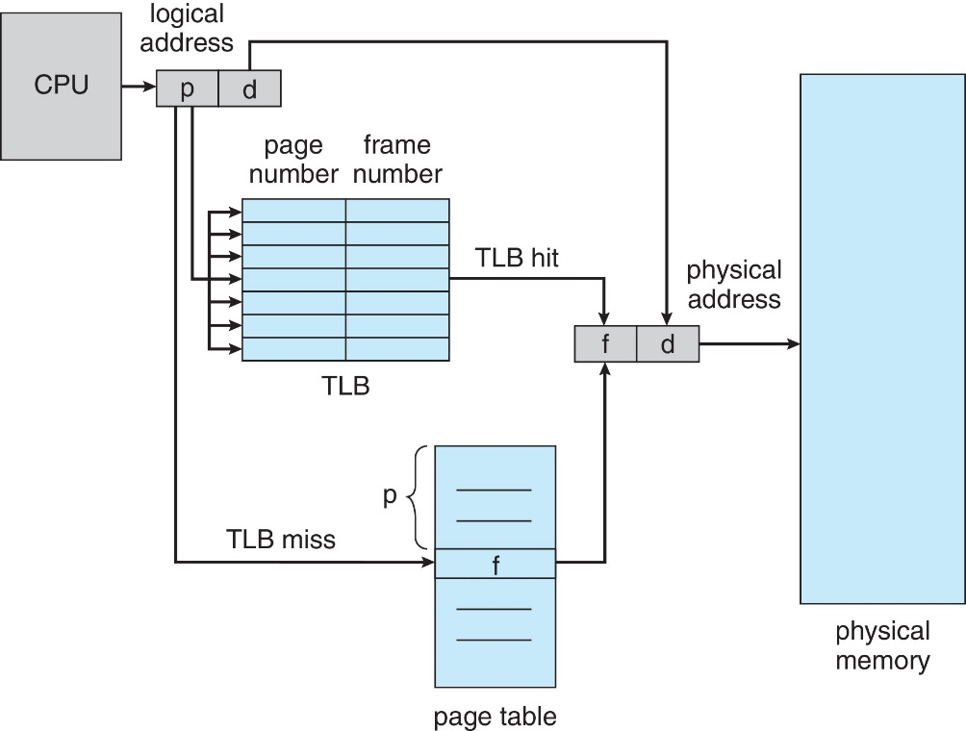
Paging Hardware with TLB
parallel search

Slide 150
TLB is the Cache of Page Table
3
7
5
12
1
2
9
6
p_{i}
1
2
2
5
3
7
4
9
5
12
…
…..

Slide 151
TLB (Cont.)
A TLB entry consists of two parts:
Key (or tag) : page number
Value : frame number
When TLB miss
Get frame number from page table
Add the (page number, frame number) information into the TLB
TLB full? => Select a victim entry for replacement
Some TLB entries can be wired-down
Never be removed from the TLB
Entries for kernel code are typically wired-down

Slide 152
Q: 當process context switch時, TLB必須flush. Why?
Ans: see the next slide

Slide 153
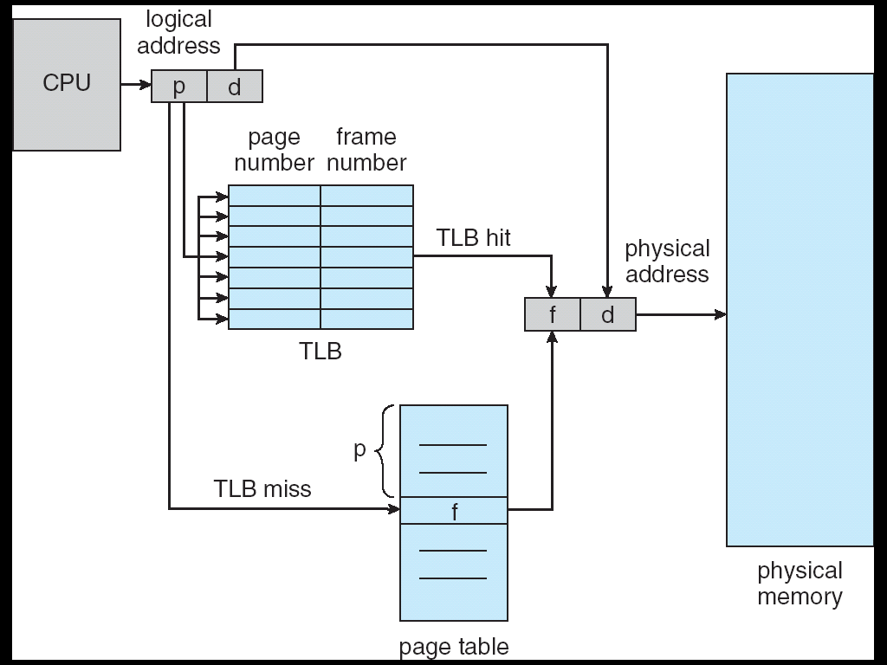
Problems With TLB When Context Switches
1
2
3
3
7
3
5
12
1
2
4
…
…
7
5
6
p_{j}
p_{i}
7
1
15
1
2
8
2
4
2
5
9
3
6
3
7
4
4
10
11
context switch
9
5
13
5
12
6
3
6
10
page table

Slide 154
同樣的, thread context switch則不用flush TLB

Slide 155
TLB (Cont.)
When context switches, TLB must be flushed
Another choice: add address-space identifiers (ASIDs) in each TLB entry
Uniquely identifies each process
ASID should be matched, otherwise, TLB miss

Slide 156
Effective Access Time
Hit ratio – percentage of times that a page number is found in TLB
Assume:
Memory access time = 10 ns,
TLB lookup has no performance penalty
If TLB miss, access time = 10 + 10 = 20 ns
Once for page table and the other for data/instruction
If TLB hit, access time = 10 ns
Only for data/instruction from memory

Slide 157
Effective Access Time (Cont.)
Assume: TLB hit ratio = 80%
Effective Access Time (EAT)
EAT = 0.8 x 10 + 0.20 x 20 = 12 ns
Suffer a 20 percent slowdown in memory access time
Consider a more realistic hit ratio of 99%,
Why so high? (第十章會介紹)
EAT = 0.99 x 10 + 0.01 x 20 = 10.1ns, Implying only 1% slowdown in access time.

Slide 158
Outline
Background
Contiguous Memory Allocation
Paging
Basic Method
Hardware Support
Protection
Shared Pages
Structure of the Page Table
Swapping
Example: Intel 32 and 64-bit Architectures
Example: ARMv8 Architecture

Slide 159
Q: 在paging架構下, 如何實現記憶體保護?
Hint: 看個例子

Slide 160
Q: if a process issue a memory access to page 6, how to detect and deny this access? and by whom?
If virtual address space = 8 pages

Slide 161
1st Solution

Slide 162
Memory Protection
By associating a protection bit with each PTE in the page table
Protection bit: valid-invalid
Valid: the page is in the process’ logical address space
Invalid: the page is not in the process’ logical address space

Slide 163

Valid (v) or Invalid (i) Bit in a Page Table for Memory Protection
If virtual address space = 8 pages, each page table entry associate with valid/invalid bit.
0 | 1 | v
1 | 4 | v
2 | 3 | v
3 | 7 | v
4 | 0 | i
5 | 0 | i
6 | 0 | i
7 | 0 | i
Valid : addr translation
Invalid: trap

Slide 164
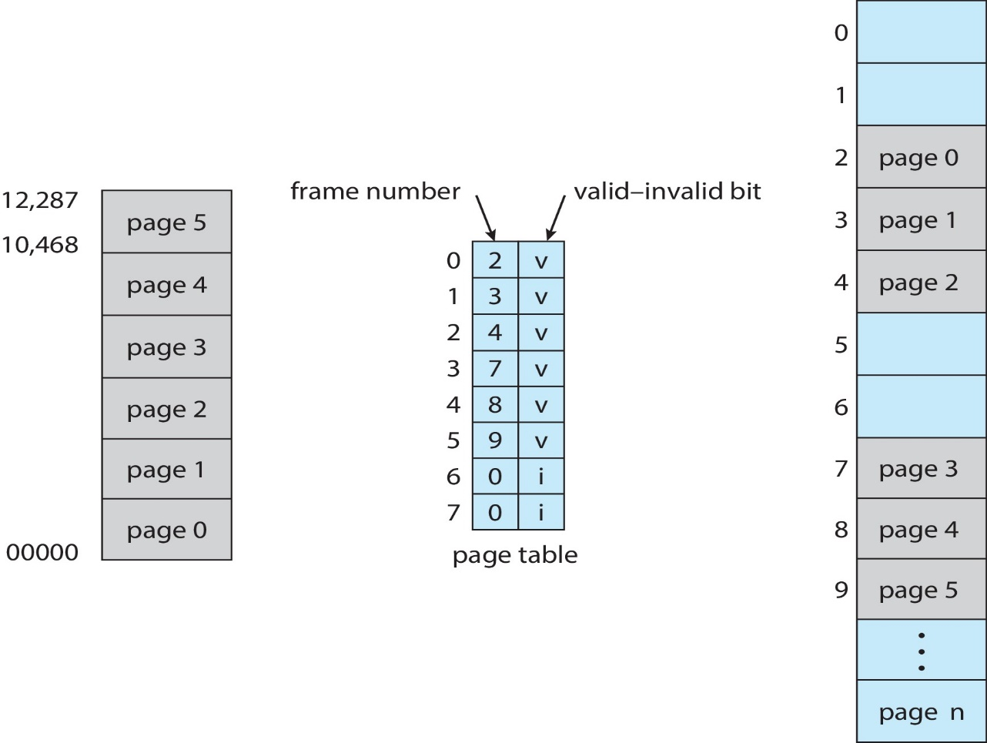
Another Example
Assume 14-bit logical address, page size = 2KB => page table entry = 8
Valid : addr translation
Invalid: trap
If a process uses address 0~10468 ⇨ need 6 pages (0~12287)
⇨ The last 2 pages marked invalid

Slide 165
Q: 1st Solution有什麼缺點呢?
Hint: 如果虛擬記憶體很大, 但是程式很小

Slide 166
Memory Protection (Cont.)
In fact, most processes only uses a small address space
Thus, few valid PTEs but many invalid PTEs in page tables
Waste memory space (Why?)

Slide 167
Q: 有什麼其他的方法呢?
Ans: 2nd Solution

Slide 168
Memory Protection (Cont.)
More promising Sol.: A page-table length register (PTLR)
Indicate the length of the page table
Example: PTLR = 4
If accessing page number > 4 => Trap
Example: If access page number = 6 > PTLR => Trap

Slide 169
Page-Table Length Register for Memory Protection
Page-table length register (PTLR) = 4
0 | 1 | v
1 | 4 | v
2 | 3 | v
3 | 7 | v

Slide 170
複習: Per-Process Page Table (Cont.)
Hardware introduces two registers
Page-table base register (PTBR) points to the page table of the current running process
Page-table length register (PTLR) indicates size of the page table (introduced later)
When processes context switch
PTBR is changed to point to the current process’s page table
PTLR is also updated

Slide 171
事實上, page table可以提供更精細的記憶體保護

Slide 172
Memory Protection
In fact, page tables can offer fine-grained protection
By associating more protection bit with each PTE
Protection bits:
Valid-invalid
Read-write, read-only, or execute-only

Slide 173
More Protection Bits in the Page Table Entries
0 | 1 | v | r
1 | 4 | v | w
2 | 3 | v | rw
3 | 7 | v | r

Slide 174
Outline
Background
Contiguous Memory Allocation
Paging
Basic Method
Hardware Support
Protection
Shared Pages
Structure of the Page Table
Swapping
Example: Intel 32 and 64-bit Architectures
Example: ARMv8 Architecture

Slide 175
Shared Pages
One promising advantage of paging is the support of sharing common code
Only one copy of the shared code is kept in physical memory
E.g., 40 users used libc at the same time and libc is 2MB
By shared page, only 2 MB, instead of 80 MB, memory is required

Slide 176

Example: Sharing of Standard C Library in a Paging Environment (Cont.)

Slide 177
Q: 在上圖, P1, P2, P3都有使用C library, 如何讓P1, P2, P3共享frame 1, 3, 4, 6呢
Ans: see the following slide

Slide 178
Example: Sharing of Standard C Library in a Paging Environment (Cont.)

Slide 179
Shared Pages (Cont.)
In fact (see the following two slides),
Shared libraries ((dynamically linked library) are typically implemented with shared pages to be shared by several processes
IPC shared memory is implemented in the same way

Slide 180
複習: Dynamic Linking
Advantages
Reduce the size of an executable image and used memory size.
Particularly useful for libraries
Libraries can be shared among multiple processes
Only one instance is needed
Needs to be loaded in main memory only once
Such libraries are called dynamically linked library (DLLs) or shared library
Windows: .DLL files
Unix: .so files (shared library)

Slide 181
複習: IPC Models
(a) Message passing. (b) Shared memory

Slide 182
Outline
Background
Contiguous Memory Allocation
Paging
Structure of the Page Table
Swapping
Example: Intel 32 and 64-bit Architectures
Example: ARMv8 Architecture

Slide 183
Motivations
Modern computer supports a large logical address space
2³² – 2⁶⁴
The page table becomes excessively large
Example
32-bit logical address space
Page size = 4KB
Page table consists of 1 million entries (2^20)
Assume each entry is 4 bytes, page table needs 4MB physical memory
We need to search a continuous physical memory of 4MB (1024 frames)
Face the same problem of contiguous memory allocation

Slide 184
Q: 怎麼辦呢?

Slide 185
Motivations (Cont.)
Solutions
Hierarchical Paging
Hashed Page Tables
Inverted Page Tables

Slide 186
Outline
Background
Contiguous Memory Allocation
Paging
Structure of the Page Table
Hierarchical Page Tables
Hashed Page Tables
Inverted Page Tables
Swapping
Example: Intel 32 and 64-bit Architectures
Example: ARMv8 Architecture

Slide 187

Hierarchical Page Tables
Idea.: divide the page table into smaller pieces
Page table becomes non-contiguous
Ex.: two-level page table
Page table itself is also paged
Page table不連續
所以需要再新增一個外部的page table

Slide 188
Two-Level Paging Scheme
Assume on 32-bit machine with 4K page size
In one-level paging scheme: a logical address is divided into:
a page number consisting of 20 bits
a page offset consisting of 12 bits
In two-level paging scheme: since the page table itself is paged, the page number is further divided into:
a 10-bit P₁.
原page table可以切割為2^10 pages，所以需要10個 bits
(2^20 entries x 4 B/entry)/4KB/page) = 2^10 pages=> P₁ = 10)
a 10-bit P₂.
20-10 = 10 or (4KB/page ÷ 4 B/entry = 2^10 entries, so P₂ = 10-bit)

Slide 189


Two-Level Paging Scheme (Cont.)
Thus, a logical address is as follows:
p₁ is an index into the outer page table,
p₂ is the displacement within the page of the outer page table.

Slide 190
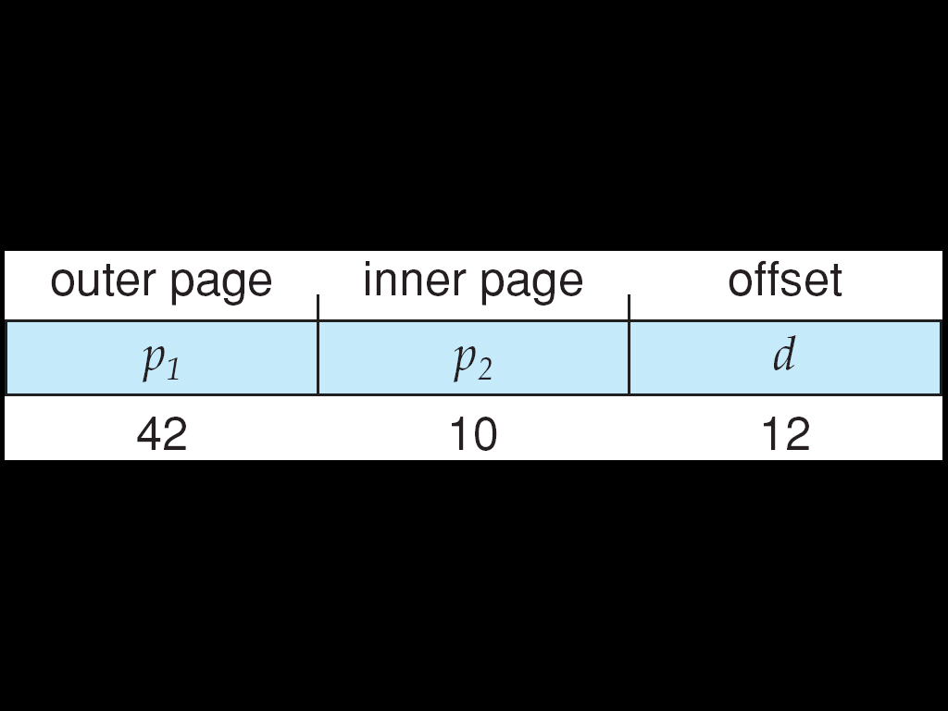
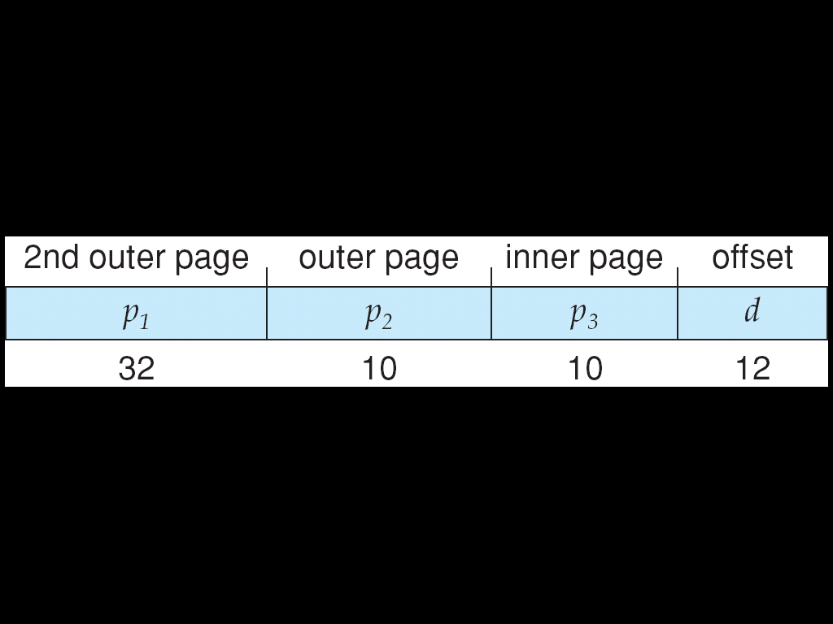
Three-level Paging Scheme
In 64-bit computers, a 64-bit logical address with 4K page size:
If two-level: p₁ is 42 bits
# of outer PT entries = 2⁴²,
If each entry is 4 bytes → need 2⁴⁴ = 16 Terabytes !!! → TOO BIG
If three-level: p₁ is 32 bits
# of 2nd outer PT entries= 2³² → need 2³⁴=16 Gigabytes !!! → TOO BIG
three-level page table

Slide 191
Hierarchical Page Tables (Cont.)
Thus, for 64-bit architectures
Hierarchical page tables is inappropriate
Example: 64-bit UltraSPARC needs seven levels of paging
A prohibitive number of memory access to translate logical addresses
Sol.:
Hashed page table
Inverted page table

Slide 192
Outline
Background
Contiguous Memory Allocation
Paging
Structure of the Page Table
Hierarchical Page Tables
Hashed Page Tables
Inverted Page Tables
Swapping
Example: Intel 32 and 64-bit Architectures
Example: ARMv8 Architecture

Slide 193
Hashed Page Tables
Common in address spaces > 32 bits
The page number is hashed into a page table.
See the next slide
Each entry contains a chain of elements that hash to the same location
Handle Collisions.
Thus, each entry consists of
Page number
Frame number
Pointer to the next hash entry
Virtual page numbers are compared in this chain to search for a match.
If a match is found, get the corresponding frame number

Slide 194
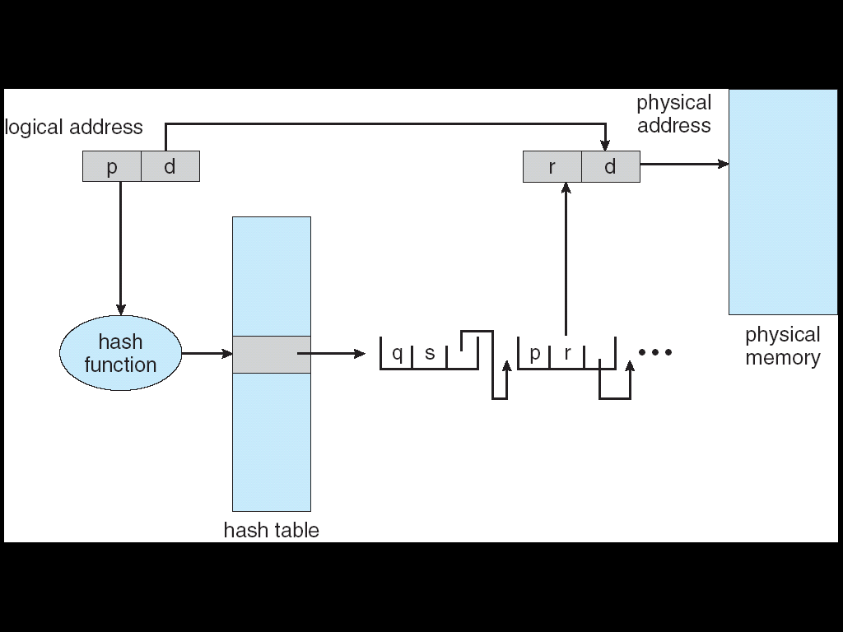
Hashed Page Table
frame number
virtual page number

Slide 195
複習: Paging Model of Logical and Physical Memory

Slide 196
Outline
Background
Contiguous Memory Allocation
Paging
Structure of the Page Table
Hierarchical Page Tables
Hashed Page Tables
Inverted Page Tables
Swapping
Example: Intel 32 and 64-bit Architectures
Example: ARMv8 Architecture

Slide 197
Inverted Page Table
Previously scheme requires that each process has a page table
This may consumes large amounts of physical memory
Solution: inverted page table (i.e., frame table)
A system wide PT instead of per-process PTs
One entry for each frame of memory
Each entry consists of (process-id, page number)
Only one inverted page table is in the system
Example: PowerPC

Slide 198
Inverted Page Table Example
Page 3
(P1)
Page 2
IPT
0
2
3
1
1
0
2
2
2
Page 1
0
6
3
1
2
1
5
Page 0
4
1
1
(P2)
2
2
5
2
1
3
0
6
2
0
7
1
3
From Ka, Ha-Zen

Slide 199
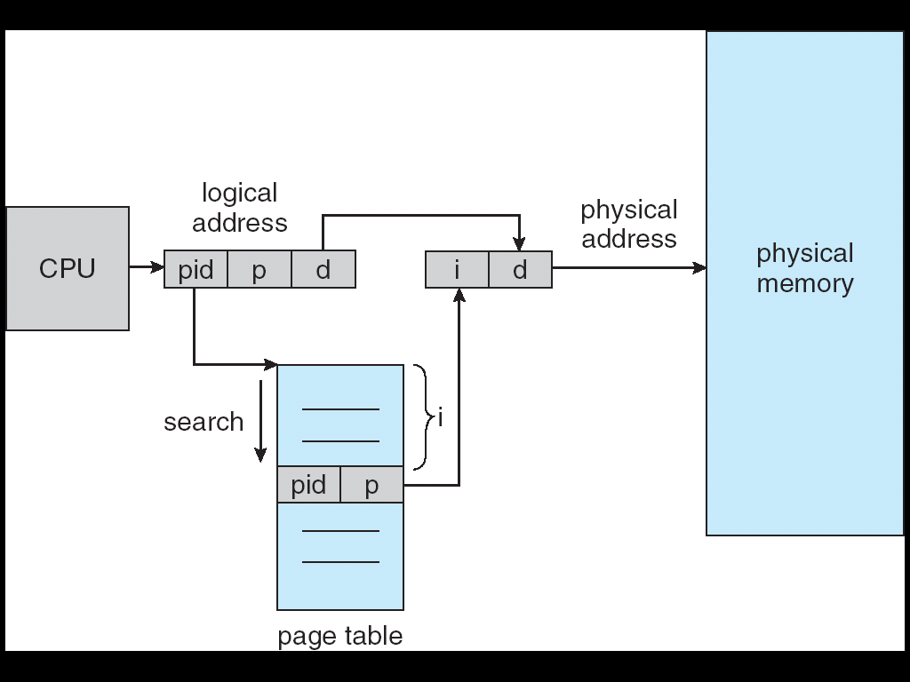
Inverted Page Table Architecture
Each memory access requires n (i.e. PT search) + 1 memory accesses

Slide 200
Inverted Page Table (Cont.)
Advantages
Decreases memory needed to store each page table,
Disadvantages
Increases time needed to search the table
The inverted page table is sorted by physical address (frame number)
But the lookup occur on virtual address (page number)
The whole table might need to be searched
Sol: use hash table to limit the search
Have difficulty implementing shared memory

Slide 201
Outline
Background
Contiguous Memory Allocation
Paging
Structure of the Page Table
Swapping
Example: Intel 32 and 64-bit Architectures
Example: ARMv8 Architecture

Slide 202
Process Scheduling
Degree of multiprogramming
The number of processes currently in memory

Slide 203
CPU Scheduling
Some OS introduces an intermediate from of scheduling: swapping
Swapping
Removes processes from memory to a backing store
Reduce the degree of multiprogramming
At some later time, the process can be re-introduced into memory
Increase the degree of multiprogramming

Slide 204
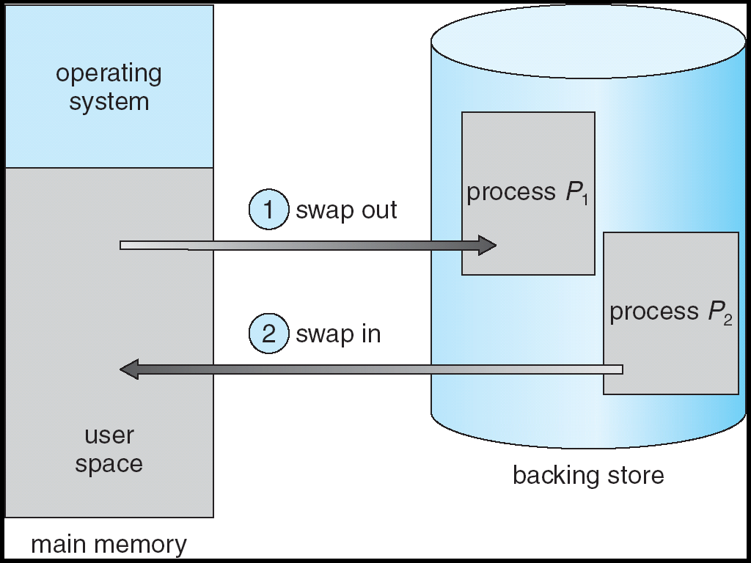
Schematic View of Swapping

Slide 205
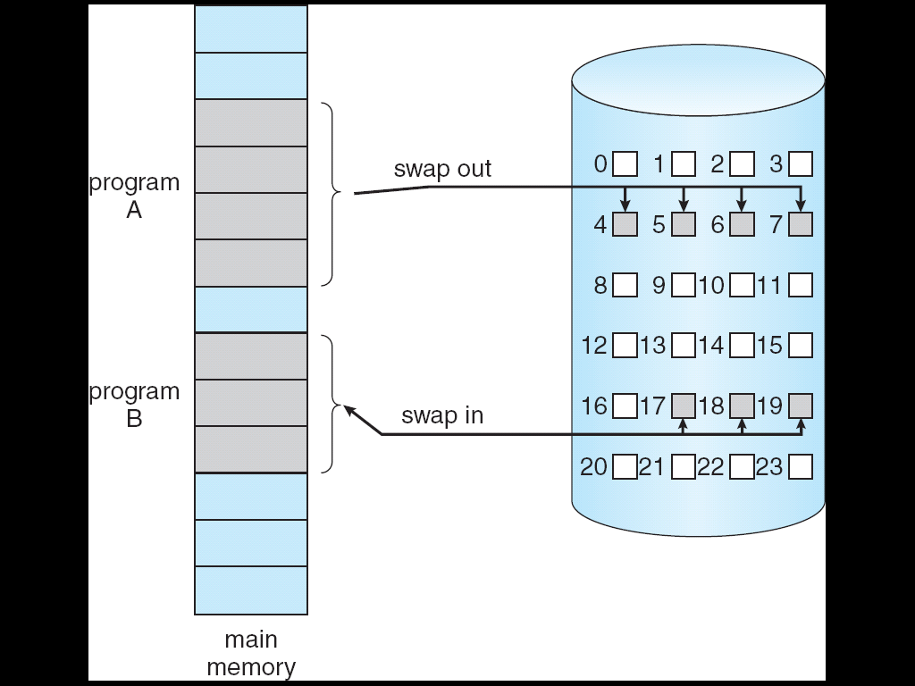
Swap Out and Swap In

Slide 206
Swapping
Advantages
The system can accommodate more processes than there is physical memory to store them
Backing store – for swap space, usually a disk partition
Good candidates for swapping out
Idle or mostly idle processes
Standard swapping is not used in current OS (Linux and Windows) – Too much swapping time

Slide 207
Outline
Background
Contiguous Memory Allocation
Paging
Structure of the Page Table
Swapping
Example: Intel 64-bit Architectures (skip!)
Example: ARMv8 Architecture

Slide 208
x86-64
64 bits is ginormous (> 16 exabytes)
In practice only implement 48 bit addressing
But can support 52-bit physical addresses (4096 terabytes) by page address extension (PAE)
Support for page sizes of 4KB, 2MB, or 1GB
Use four levels of paging hierarchy

Slide 209
Outline
Background
Contiguous Memory Allocation
Paging
Structure of the Page Table
Swapping
Example: Intel 32 and 64-bit Architectures
Example: ARMv8 Architecture (Skip!)

Slide 210
ARM Architecture
Dominant mobile platform chip (Apple iOS and Google Android devices for example)
32-bit ARM architecture supports the following page sizes
4 KB, 16 KB, and 64 KB
Three-level paging for 64 KB pages
Four-level for smaller pages (4KB and 16KB)
Two levels of TLBs
Outer level has two micro TLBs (one data, one instruction)
Inner is single main TLB
First inner is checked, on miss outers are checked, and on miss page table walk is performed by CPU

Slide 211
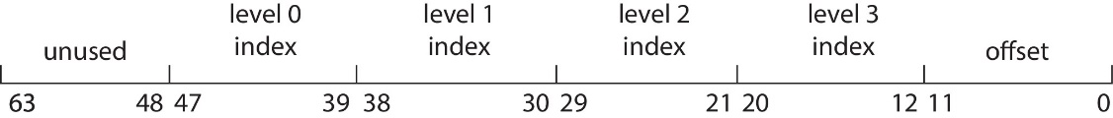
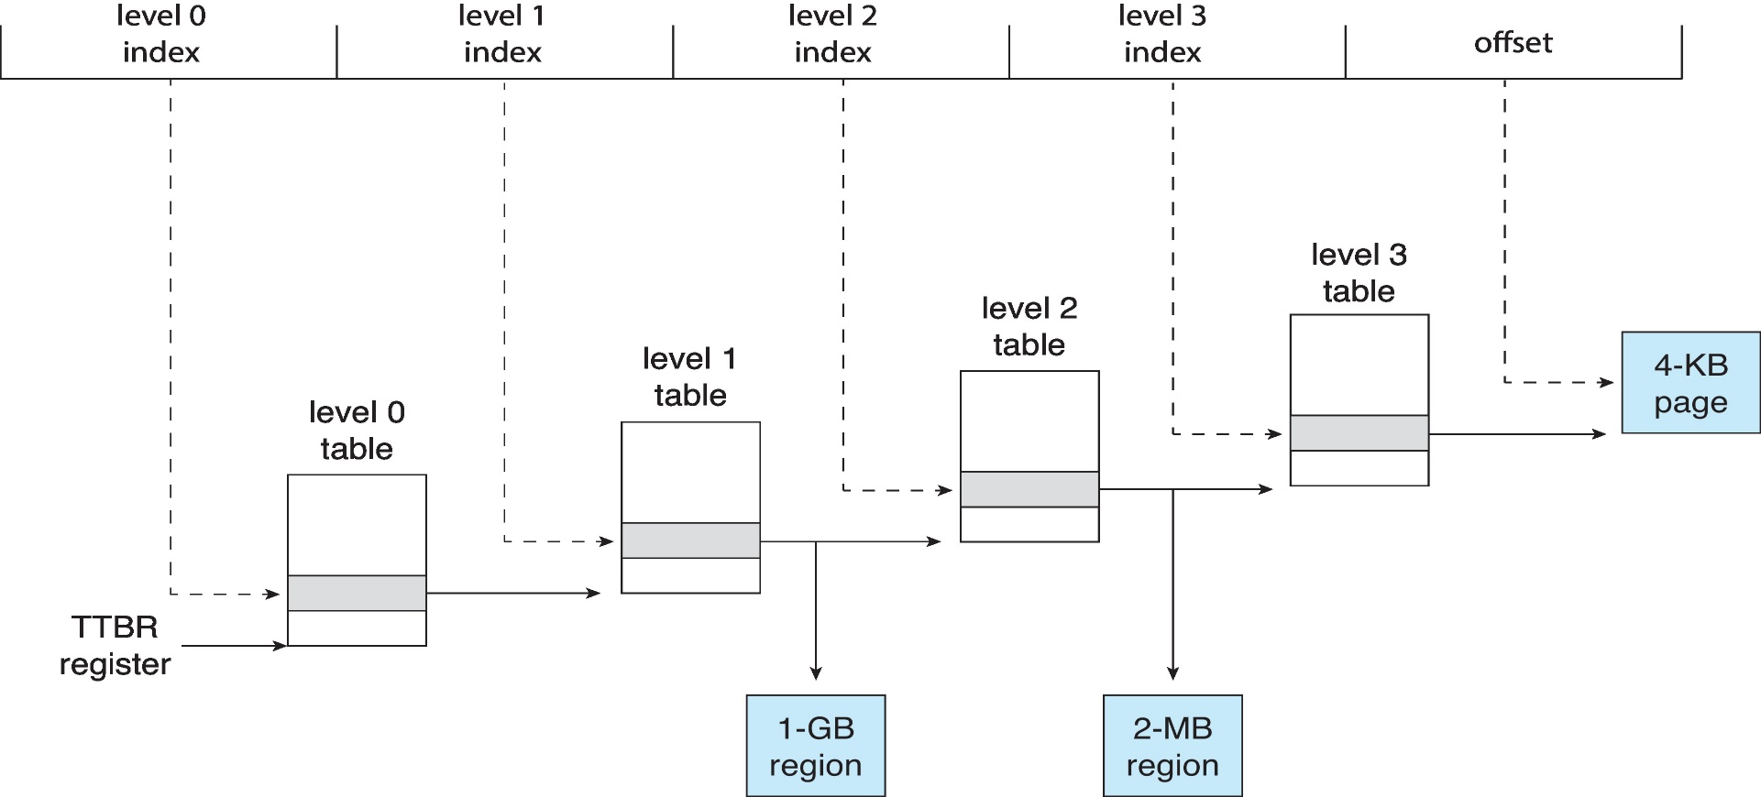
ARM 4-KB Translation Granule
ARM Four-Level Hierarchical Paging

